Slide 1

Module 5
-
Undertaking gender assessments for conservation
Uganda Wildlife Authority
Community Conservation Wardens
Training Pack: 2018 & 2019

Slide 2
This module is part of the UWA Community Conservation Warden training package, which was designed for UWA, with support from IIED and funding from UK Aid. The package contains the following modules:
Introduction to Community Conservation
Effective Communication
Community Mobilisation
Facilitating Community Meetings
Undertaking Gender Assessments for Conservation
Planning Community Conservation Interventions and Projects
Conflict Management
Monitoring & Evaluation Reporting
All modules can be found via www.iied.org/UWA-warden-training

Slide 3
Module 5: Undertaking Gender Assessments for Conservation
1. The concept of gender
Learning objective: Improve understanding of the concept of gender and its importance for successful community conservation
2. Why is gender important in conservation?
Learning objective: Understand how gender affects the involvement of women and men in conservation, and the benefits they obtain from it
3. Gender integration
Learning objective: Gain a foundational knowledge of gender integration and gender analysis

Slide 4
1. The concept of Gender
Learning objective 1: Improve understanding of the concept of gender and its importance for successful community conservation

Slide 5
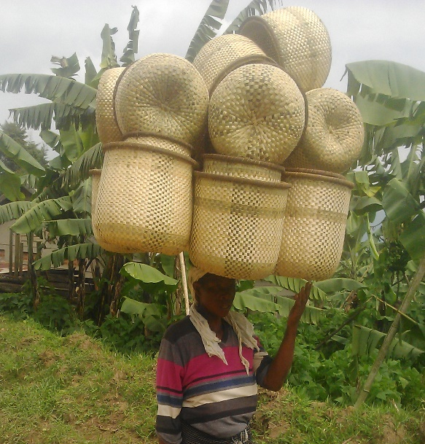
Group activity: 5 minute brainstorm
What do we understand
by “gender”?

Slide 6
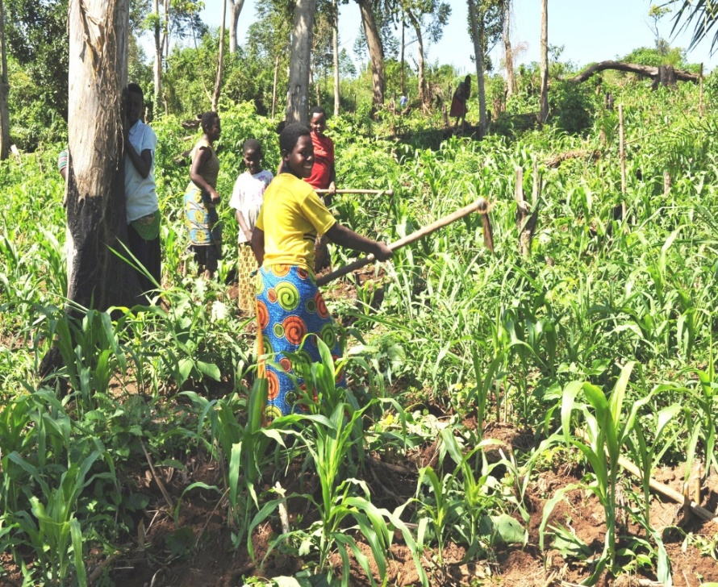
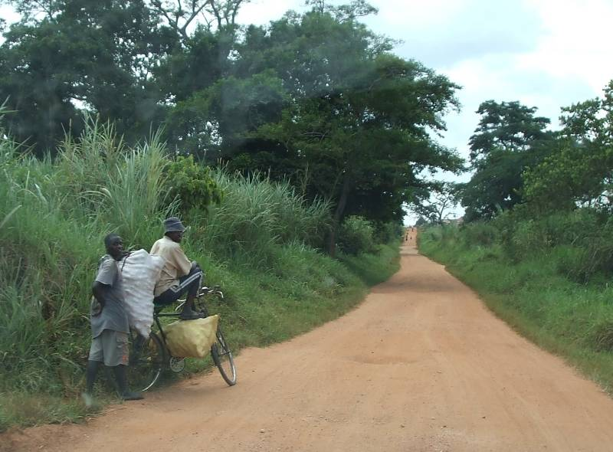
Gender
Gender is not biologically determined
It is a social construct of sets of roles, responsibilities and rights, which differ depending on whether you are a woman or a man
The way gender is socially constructed varies across cultures and time
This powerful social construct influences expectations society has of women and men, and in turn influences which activities are undertaken by women, and which by men
“Gender” is not interchangeable with “sex”

Slide 7
Group activity: Gender recap
Based on your new knowledge, how might you explain to a colleague how gender is a social construct?
Think about how expectations of women and men have changed over time, job roles performed by women and men, expectation of performing domestic chores etc.

Slide 8
Why is gender important?
Women and men have different societal roles, and the value attached to them, influence their opportunities and access
  Natural resources, information, services, facilities, time, credit, employment etc.
Gender also determines access by women and men to the benefits from conservation projects and programs
Often men represent households in community decision-making about conservation and natural resources – is this fair? Is this wise?
Namara (2015)

Slide 9
Why is gender important?
Gender blindness (ignoring gender) does not lead to equitability or fairness!
Gender differences lead to inequitable participation in conservation decision-making, and uneven distribution of burdens and benefits
Women and men have different relationships to and knowledge on natural resources; participation from only one group leads to incomplete data and partial understanding of a situation!

Slide 10
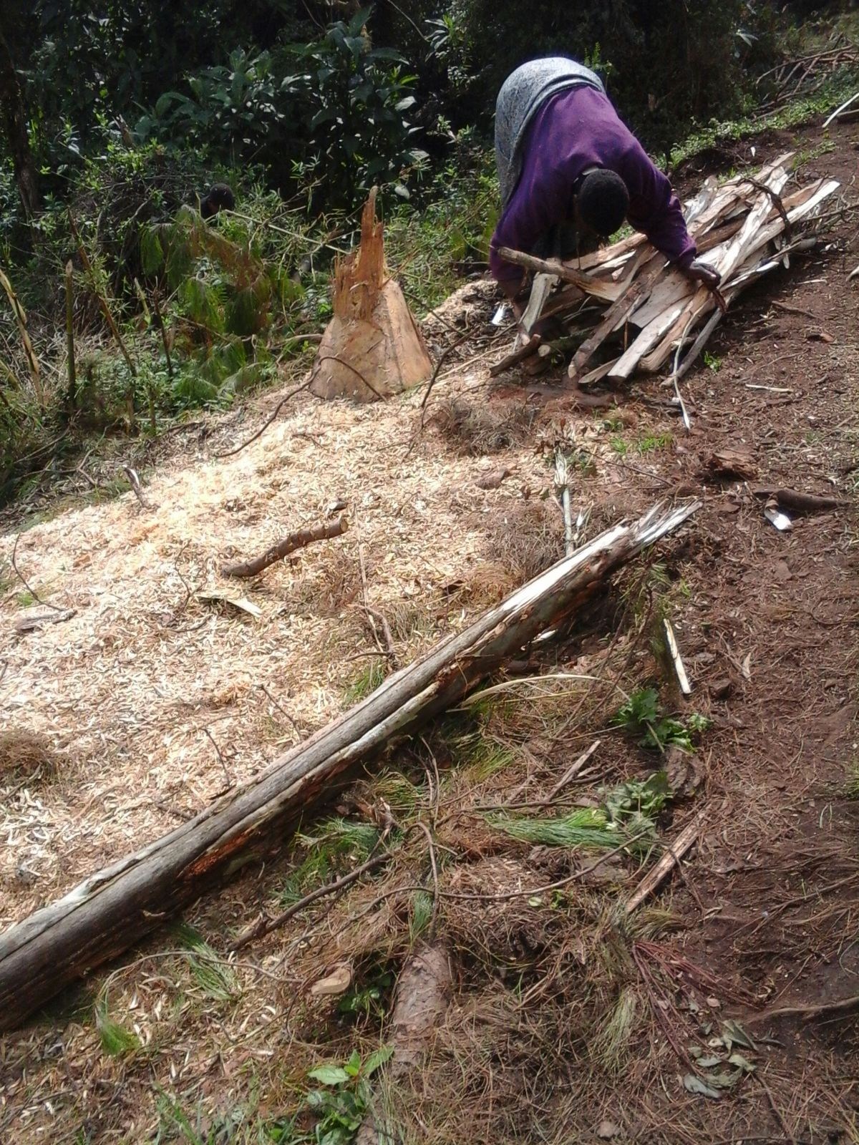
Gender and work
Internal household power relations determine labour, decision-making, ownership and control of assets among women, men, girls and boys
Generally, women do most unpaid household activities (‘reproductive’ labour)
Different value is placed on ‘reproductive’ and ‘productive’ labour – “My wife doesn’t work”
Sometimes women are even paid less than men for the same job
Female employees are assumed to have fewer responsibilities than male employees

Slide 11
Case Study: Gender and tourism employment in Bwindi
A survey was undertaken of tourism lodges around the Bwindi National Park to understand whether lodges were employing both women and men. Most jobs were taken by men, and 5 lodges had no female employees at all.
Namara (2015)

Slide 12
Case Study: Gender and tourism employment in Bwindi
Highest level of female employment was in the low level positions
Lowest level of female employment in senior management positions
Namara (2015)

Slide 13
Case Study: Gender and tourism employment in Bwindi
Lodge owners were interviewed to understand why fewer women were employed than men in tourist lodges. This gave insight into employers’ perceptions about women
Some lodge owners believed that women’s domestic responsibilities would:
prevent women working away from home
cause women to report to work late
cause high levels of absenteeism among women workers
These are only their beliefs, not the facts!
Namara (2015)

Slide 14
Case Study: Gender and tourism employment in Bwindi
The study also found that many lodge owners believed that:
women were less suitable than men for working in remote locations near the national park (marital status plays a role)
women were less able than man to undertake multiple labour demands (e.g. security, lifting heavy luggage etc.)
with a mixture of both women and men employed, there might be issues arising from possible intimate relations
These beliefs were only beliefs, and the actual situation could be very different, but lodge owners believed women were less desirable to employ than men
Namara (2015)

Slide 15
Case Study: Gender and tourism employment in Bwindi
This is a real-life example of how gender (societally-determined roles and expectations) is shaping conservation-related employment opportunities, and by extension engagement with and attitudes to conservation!
Namara (2015)

Slide 16
2. Why is gender important in conservation?
Learning objective 2: Understand how gender affects the involvement of women and men in conservation, and the benefits they obtain from it

Slide 17
Common misconceptions
“Gender is just about women!”
  Thinking about gender means ensuring that differing perspectives and needs of both women and men are taken into account
“Thinking about gender is too complicated, costly and time-consuming!”
  Gender responsiveness increases program effectiveness and sustainability
  Women have valuable knowledge and skills, which can inform and benefit programs

Slide 18
Common misconceptions
“As conservationists, it’s not our job to think about cultural issues like gender!”
  Community conservation interventions already attempt to intervene in culture by e.g. incentivising behavioural change
  Almost all UN states have committed to promoting gender equality and women’s rights; it’s our duty to be gender-sensitive

Slide 19
Group activity: 5 minute brainstorm
What gender issues have you experienced in the implementation of community conservation programs?
Make notes on a flip chart. Keep hold of the paper, as it will be used again later in the session

Slide 20
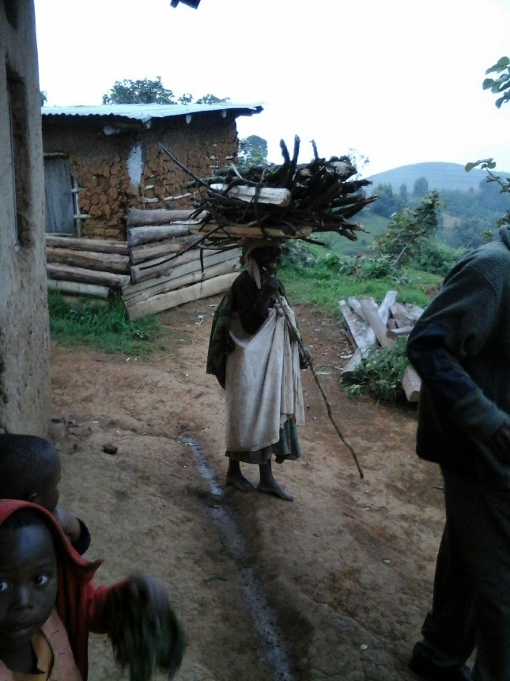
Gender and experiences of conservation
Communities living adjacent to a PA may be disadvantaged, but women are often more affected than men:
  Main household providers of food, water, firewood – restricting access to certain areas places a burden on women’s time
  Women as majority of the labour force in agriculture
Natural resource shortage/conflict/wildlife crime affect women differently to men
  More vulnerable to poverty and food insecurity
Women’s voices may be excluded
  Women’s reproductive labour duties might limit the time they can spend in conservation project consultative processes

Slide 21
Case Study: Gender and experiences of conservation
Governance Assessment for Protected and Conserved Areas, Lake Mburo, IIED 2018
“Women participants in the assessment noted that, while they might be part of decision making to identify their needs for revenue sharing projects (for example, livestock or handicraft projects), they generally felt excluded from LMNP decision making. They protested that it is unfair that they are not able to participate in decision making related to access to resources, especially regarding resources that they depend on such as fish and firewood”
Franks and Booker (2018), Governance Assessment for Protected and Conserved Areas (GAPA), p34

Slide 22
What can we do?
Often conservation program implementers miss women’s perspectives and participation
Thus implementers need to think about Gender Integration in their programs
  to understand the social and cultural context within which conservation activities are implemented
  to understand how conservation impacts, or is impacted by, gender dimensions

Slide 23
3. Gender integration
Learning objective 3: gain a foundational knowledge of gender integration and gender analysis

Slide 24
Gender Integration
Implies working towards the goal of gender equality – i.e. “equal access to opportunities, treatment under law, equality of voice”
Addresses gender differences during program or activity design, implementation, monitoring and evaluation
Involves identifying appropriate indicators on gender to guide project implementation and monitoring
Means ensuring gender is explicitly addressed in all processes and activities – not as a separate or stand-alone issue

Slide 25
Gender Integration
There are three main steps in integrating gender into a project:
Collection of sex-disaggregated baseline data
Gender-sensitive project design
Developing indicators for monitoring gender integration throughout the project cycle

Slide 26
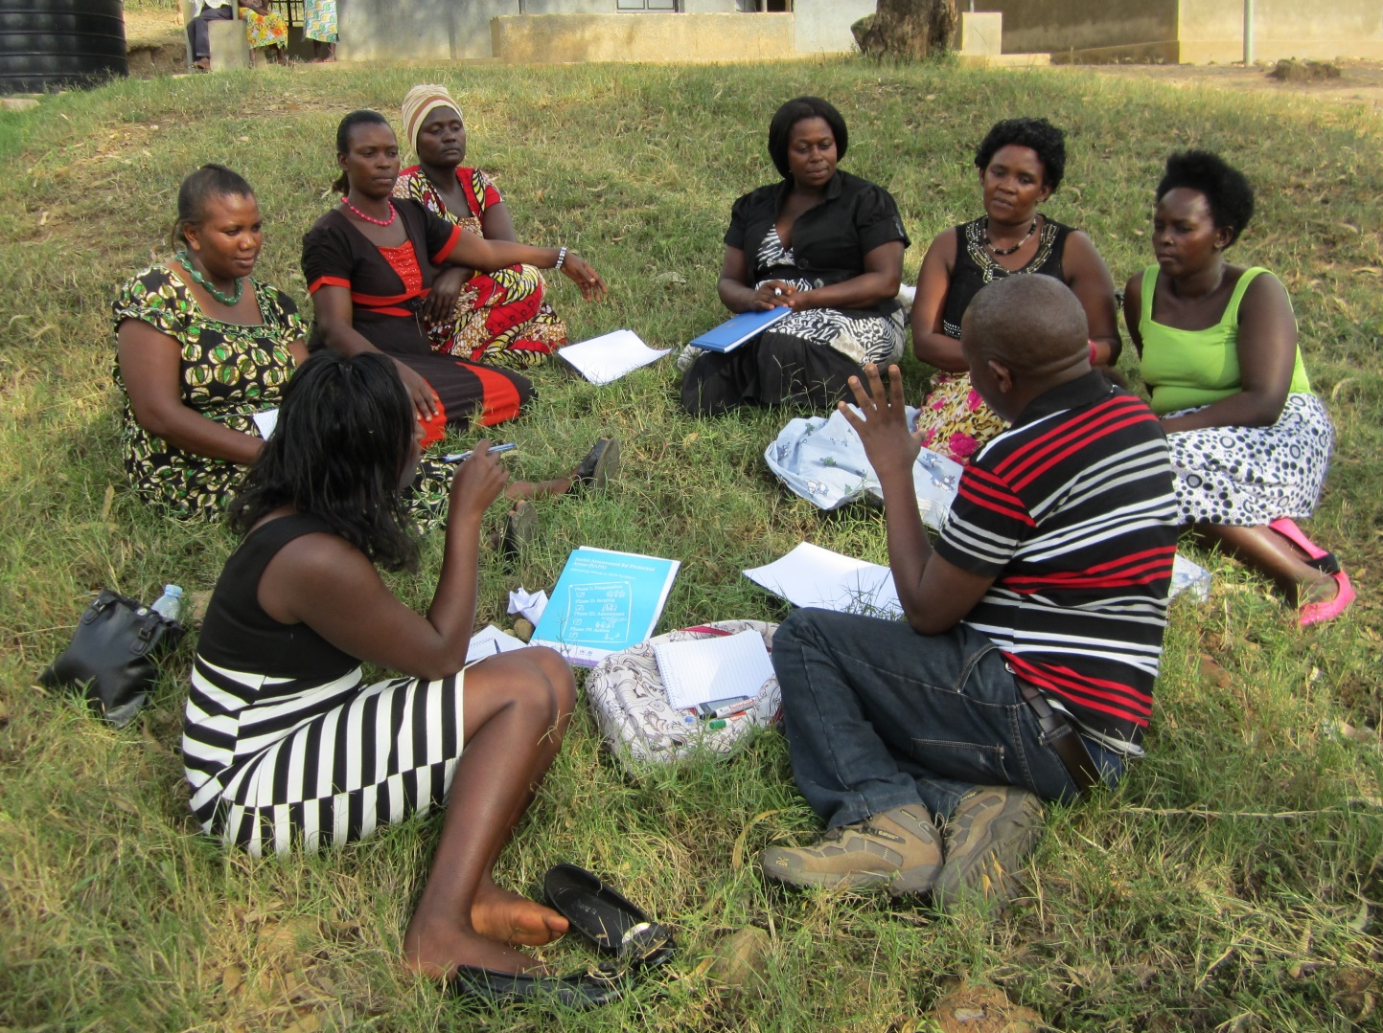
Step 1 – Baseline Data
Robust sex-disaggregated data is the basis for gender integration
Consider gathering data on:
  the structure and function of existing projects (if applicable)
  gender norms, roles and values in the project context
  gender-based constraints and opportunities in the project context
Schneider et al (2016)

Slide 27
Step 1 – Baseline Data
  Possible data collection methods include:
  Literature review (is there any existing data available?)
  Interviews
  Focus groups
  Participatory rural appraisal (workshop activities)
  Surveys
  Spatial data
  For more detail see Schneider et al (2016)

Slide 28

Data collection in action: A woman living near to Lake Mburo National Park in Uganda gives her view on living close to wild animals, who destroy her banana plantations
https://www.youtube.com/watch?v=CvW_YfttlnQ

Slide 29
Case study: Sex-disaggregated data on protected areas and well-being, Rwenzori, 2016
Research on wellbeing from IIED’s SAPA project
Key aspect was examining awareness of key information about Rwenzori Mountains National Park (RMNP)
Researchers gathered sex-disaggregated data on this
Franks and Small 2016, Understanding the social impacts of protected areas: a community perspective, http://pubs.iied.org/pdfs/14661IIED.pdf

Slide 30
Case study: Sex-disaggregated data on protected areas and well-being, Rwenzori, 2016
Selected results
Respondents were asked to identify the source of revenue-sharing funding (i.e. RMNP)
  65% of male respondents correctly identified the source, compared to 26% of female respondents
Respondents were asked about the frequency of receiving information about RMNP from UWA staff
  15% of male respondents reported that they had never received any information, compared with 35% of female respondents
Franks and Small 2016, Understanding the social impacts of protected areas: a community perspective, http://pubs.iied.org/14661IIED.

Slide 31
Thinking point: Sex-disaggregated data on protected areas and well-being, Rwenzori, 2016
Evidently there is a major discrepancy between women’s and men’s knowledge about RMNP and revenue-sharing
What could the consequences have been for future community conservation activities around RMNP, if the researchers had not collected sex-disaggregated data?

Slide 32
Step 2: Project Design
Use the information from Step 1 to design or adjust a project to lead to improved gender equity – participation is key!

Slide 33
Step 2: Project Design
Use the baseline data to think about:
  What are the gender differences that could affect the achievement of intended results?
  What is the likely effect?
  Are women and men involved or affected differently?
  Would this difference be an important factor in achieving positive and sustainable program impact?
  How might proposed results affect the relative status of women and men?

Slide 34
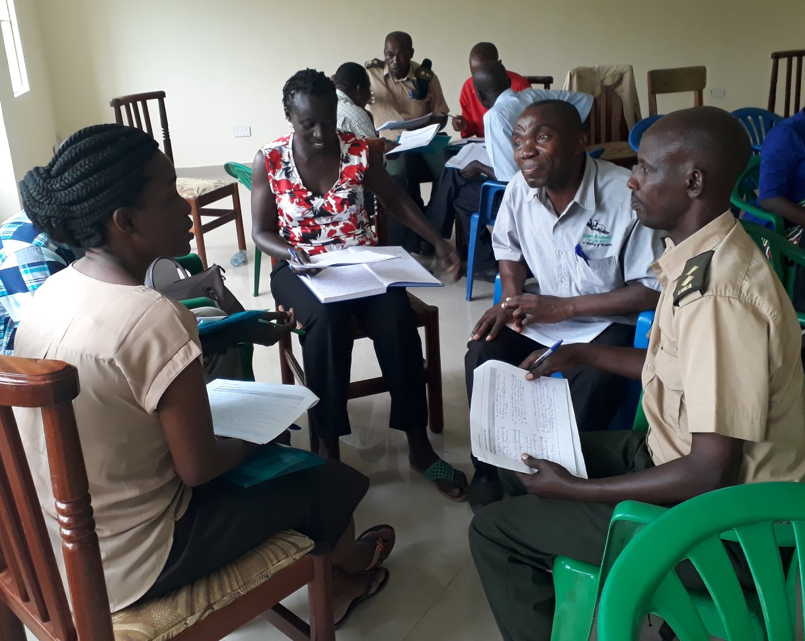
Step 2: Project Design
  Project design should be participatory – it should take into account stakeholder needs and perspectives. One way to do this is to use workshops to co-design projects:
  Include women’s organisations and gender-focused NGOs to give input about project
  Think about accessibility of venues for women and men: timing (daily and seasonal schedules), location (distance), venue (neutral, non-intimidating)
  Conduct separate men’s and women’s discussion groups as well as joint groups
See references at end of presentation for more resources!

Slide 35
Step 3: Developing Indicators
Adapt and develop project indicators for monitoring gender integration throughout the whole project cycle
How does this work in practice?
Schneider et al 2016

Slide 36
Brainstorm: Developing Indicators for integrating gender into the Lake Mburo General Management Plan Community Conservation and Development Program (CCDP)
The following slides show summarised extracts from the Lake Mburo General Management Plan’s Community Conservation and Development Program (CCDP)
Specifically, the slides show selected CCDP Objectives, the Indicators for monitoring that Objective, and the Means of Verification for the Indicators
As we discuss the slides, think about how the Indicators and Means of Verification could be altered or added to in order to integrate gender into the CCDP

Slide 37
Indicators | As in the GMP |  | Gender-integrated
Objective | Indicators | Means of verification | Indicators | Means of verification
Output 3: Community benefits in the Conservation Area diversified and improved.
Develop and review resource access guidelines (fish, firewood, water, acacia, beekeeping) | Number of resource access guidelines | Copies of approved/signed guidelines
What Indicators and Means of Verification could we use to ensure this objective is gender-integrated?

Slide 38
Indicators | As in the GMP |  | Gender-integrated
Objective | Indicators | Means of verification | Indicators | Means of verification
Output 3: Community benefits in the Conservation Area diversified and improved.
Develop and review resource access guidelines (fish, firewood, water, acacia, beekeeping) | Number of resource access guidelines | Copies of approved/signed guidelines | Resource access guidelines developed/reviewed with input from both women and men in the frontline communities | Records of consultation and review processes
 |  |  | Resource access guidelines that cater for the needs of both women and men in PA-adjacent communities in place | Copies of the guidelines
 |  |  | Numbers of women and men involved in developing/reviewing resource access guidelines

Slide 39
Indicators | As in the GMP |  | Gender-integrated
Objective | Indicators | Means of verification | Indicators | Means of verification
Output 3: Community benefits in the Conservation Area diversified and improved.
Conduct resource inventory for identified resource needs by the community |  | Quarterly, annual and special reports Field visits
What Indicators and Means of Verification could we use to ensure this objective is gender-integrated?

Slide 40
Indicators | As in the GMP |  | Gender-integrated
Objective | Indicators | Means of verification | Indicators | Means of verification
Output 3: Community benefits in the Conservation Area diversified and improved.
Conduct resource inventory for identified resource needs by the community |  | Quarterly, annual and special reports Field visits | Resource inventories developed with input from both women and men in frontline communities | Records of inventory process
 |  |  | Numbers of women and men involved in the resource inventories

Slide 41
Indicators | As in the GMP |  | Gender-integrated
Objective | Indicators | Means of verification | Indicators | Means of verification
Output 3: Community benefits in the Conservation Area diversified and improved.
Develop new MoUs and review existing ones for resource access | MoUs developed and reviewed | Copies of approved / signed MoUs
What Indicators and Means of Verification could we use to ensure this objective is gender-integrated?

Slide 42
Indicators | As in the GMP |  | Gender-integrated
Objective | Indicators | Means of verification | Indicators | Means of verification
Output 3: Community benefits in the Conservation Area diversified and improved.
Develop new MoUs and review existing ones for resource access | MoUs developed and reviewed | Copies of approved / signed MoUs | MoUs reviewed with input from both women and men in the frontline communities | Records of consultation process
 |  |  | Number of men and women involved in review of MoUs | Copies of the MoUs
 |  |  | Number of women in CRM [community resource management?] groups and executive committees | Survey, focus group discussions
 |  |  | Number of CRM groups reporting satisfaction with the terms of their resource access MoUs | Community Conservation Department records / reports

Slide 43
Brainstorm: Developing Indicators for integrating gender into the Lake Mburo GMP Community Conservation and Development Program (CCDP)
It is always possible to integrate gender considerations into projects!
Ensure the GMP consultation processes seek perspectives of both women and men
Think carefully about equal gender representation throughout whole project cycles (see also Module 7: Conflict Management)
Seek feedback from women and men through periodic monitoring of interventions (see also Module 8: Monitoring & Evaluation Reporting)
Use monitoring to anticipate / resolve issues as they arise

Slide 44
Group activity: 5 minute brainstorm
Go back to your notes on the brainstorm exercise from Slide 19
What indicators might you use to address these issues and monitor the implementation of community conservation activities?

Slide 45
Challenges in integrating gender
Gender blindness among the key decision-making bodies (e.g. top management, PA managers and staff)
  Gender awareness is not a key skill during recruitment
  Danger of tokenism: gender as mere “add-on”
  As a response, UWA could consider an in-house gender specialist, or gender-awareness training as part of staff development

Slide 46
Challenges in integrating gender
‘Gender fatigue’ – perceived imbalance in the relative amount of resources being directed to women; gender seen as a western imposed notion
  Focus gender discussions on specific and easily understandable areas (e.g. what happens to proceeds from honey at household level?)
  Focus on fairness
  Avoid controversy that arises from the sensitive aspects of gender equity

Slide 47
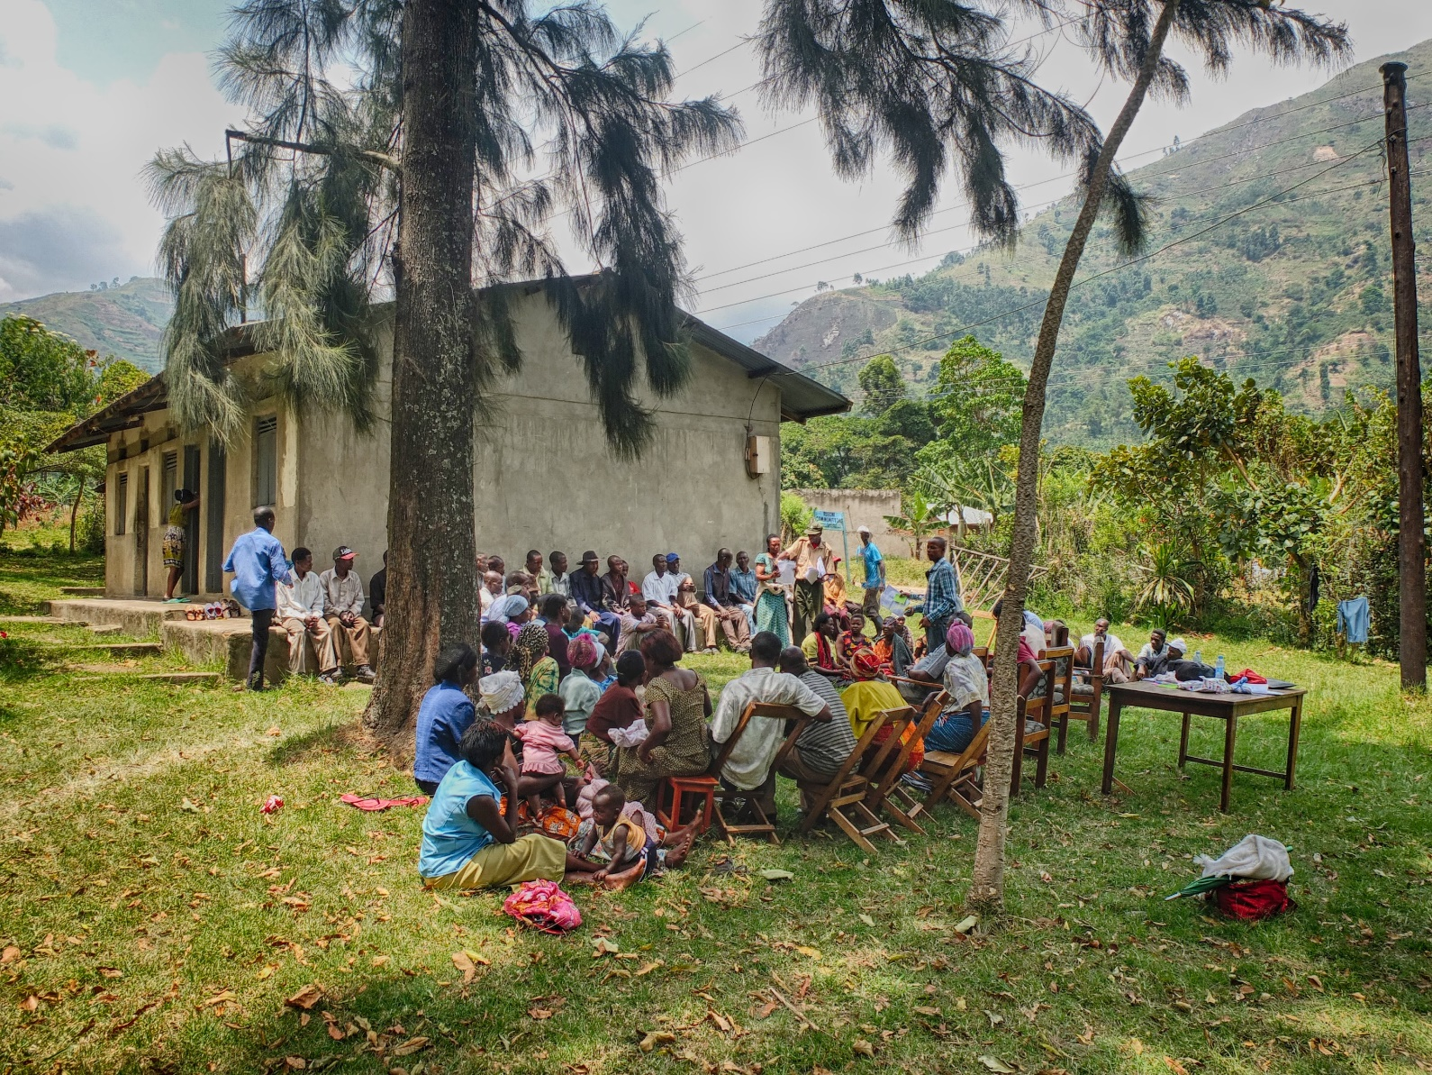
Challenges in integrating gender
Collecting gender-disaggregated baseline data is crucially important first step
  This requires resources and dedication!

Slide 48
To sum up....
Gender is a social construct which shapes behaviour, rights, access and distribution of resources
Gender inequality leads to inequitable participation in and benefit from conservation and development interventions
Women and men often do not use, depend or value natural resources in the same way
Gender inequality and gender blindness makes conservation harder

Slide 49
To sum up....
This is why we must have good quality sex-disaggregated data to inform our actions throughout projects, and ensure both women’s and men’s voices are heard!

Slide 50
Don’t forget!
Turn to the Work Plan in your training manual and think about your key learning from today, and how you might apply it in practice!

Slide 51
Acknowledgement
These modules were developed and administered by Mrs Eunice Duli and Mrs Agripinnah Namara

Slide 52

Thank you
This training is part of the project: Implementing park action plans for community engagement to tackle IWT, coordinated by IIED and grant funded by the UK government’s Illegal Wildlife Trade (IWT) Challenge Fund.
The IWT Challenge Fund is for projects around the world tackling illegal wildlife trade and supports action in three areas, including developing sustainable livelihoods for communities affected by illegal wildlife trade. The views expressed are not necessarily the views of the UK government.

Slide 53
References
Franks and Small 2016, Understanding the social impacts of protected areas: a community perspective, http://pubs.iied.org/pdfs/14661IIED.pdf
Namara 2015, Tourism-related employment of local people around Bwindi Impenetrable National Park, Uganda, http://pubs.iied.org/pdfs/G03942.pdf
Republic of Uganda 1995, The Constitution of the Republic of Uganda
Republic of Uganda 2007, Uganda Gender policy
Schneider et al 2016,INTRINSIC: Integrating Rights and Social Issues in Conservation (A Trainer’s Guide), http://www.cambridgeconservation.org/resource/toolkits/intrinsic-integrating-rights-and-social-issues-conservation-trainers-guide
UWA, 2015, Lake Mburo Conservation Area General Management Plan, http://www.ugandawildlife.org/images/pdfs/general_management_plans/Lake_Mburo_Conservation_Area_GMP_%202015-2025.pdf

